Slide 1
COS70006 OOP
Flow of Control
Based on reference textbooks
Notes:
Sunday, 11 August 2019
A Bayley
1

Slide 2
Flow of control
A default of order of Java code execution in a code block is sequential in the order of statements being written.
However, the order can be changed based on some mechanisms to decide whether to execute or to repeat the execution of a piece of code.
The order of statement execution is called the flow of control
As in most programming languages, flow of control in java refers to branching (conditional statements) and looping (iteration) mechanisms.

Slide 3
Flow of control
In java, most branching and looping statements are controlled by Boolean expression.
Branching statements:
If statement: do the action only if condition is true
If-else statement: do one action if condition is true, and do the other if not
Switch statement: for multiple options

Slide 4
Boolean expression
An expression which evaluates to either true or false
The evaluation is mostly based on comparisons. The simplest Boolean expressions compare the value of two expressions: score1 > score2
Comparison operators:
Less than (<): time < limit
Greater than (>) : time > limit
Less than or equal to (<=): 3<=3
Greater than or equal to (>=): 3>=3
Equal to (==): answer == ‘y’
Not equal to (!=): answer !=‘y’

Slide 5
Comparison
Between primitive values:
int: 3<5 is true
char: based on Unicode values of the characters:
‘a’ < ‘z’ is true
‘A’ < ‘a’ is true
double: usually we do not compare between double variables as they are not store precisely

Slide 6
Comparison - warning
Between objects:
Suppose String str = “abc”;
str == “abc” is true or false?
We can use the equality comparison operator (==) to correctly test two values of a primitive type
However, when comparing two objects of the String class, == tests to see if they are stored in the same memory location, not whether or not they have the same value, so str == “abc” is false

Slide 7
Comparing Strings
In order to test two strings to see if they have equal values, use the method equals, or equalsIgnoreCase
string1.equals(string2)
string1.equalsIgnoreCase(string2)
compareTo() and compareToIgnoreCase() methods:
Suppose:
String str1 = "Negan";
String str2 = “Apple"; //empty string
str1.compareTo(str2); would return a positive number
str2.compareTo(str1); would return a negative number

Slide 8
More example
After program executes String entry = "adventure";
entry.compareTo("zoo") returns a negative number,
entry.compareTo("adventure") returns 0, and
entry.compareTo("above") returns a positive number.
After program executes String entry = "adventure";
entry.compareToIgnoreCase("Zoo") returns a negative number,
entry.compareToIgnoreCase("Adventure") returns 0, and
"Zoo".compareToIgnoreCase(entry) returns a positive number.

Slide 9
Building Boolean Expressions
Multiple Boolean expressions can be combined and evaluated using logical operators.
"and" (&&) operator: the entire expression is true provided both expressions are true, Otherwise the expression is false
(age >=3) && (age <=30)
"or" (||) operator: the entire expression is true as long as one of the expressions is true; the expression is false only if both expressions are false
(age <3) || (age >30)

Slide 10
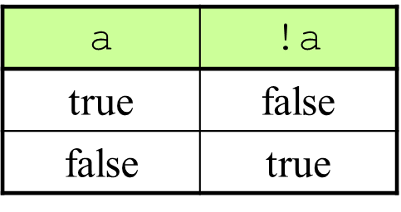
Logical operators
! operator: any Boolean expression can be negated by placing the ! operator in front of it
!true is false: ! (3 ==3) -> false
!false is true: : ! (3 ==4) -> true
exp1 | exp2 | exp1 && exp2 | exp1 || exp2
true | true | true | true
true | false | false | true
false | true | false | true
false | false | false | false

Slide 11
Operator Precedence
Parentheses () can always be used to override the default precedence
In table below, highest precedence is on top of the table.
prefix and negate | ++ -- !
multiplicative | * / %
additive | + -
equality | == !=
Rational operators | < <= > >=
logical AND | &&
logical OR | ||

Slide 12
The if-else Statement
A branching statement that chooses between two alternative groups of statements: Either this, or that
Syntax
if (Boolean_Expression)
Statement_1
else
Statement_2
must be enclosed in parentheses
If the Boolean_Expression is true
If the Boolean_Expression is false

Slide 13
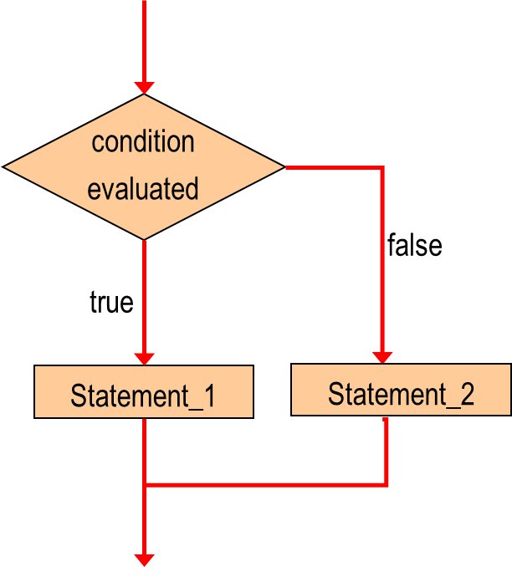
Logic of if-else statement

Slide 14
Example
Single statement
if (balance >= 0)
balance = balance + 50;
else
balance =balance − 50;

Slide 15
Compound Statement
Statement_1 and Statement_2 can each be a single statement or many statements (compound Statement)
To include multiple statements in a branch, enclose the statements in braces { }:
if (myScore > your Score) {
System.out.println("I win!");
wager = wager + 100;
}
else {
System.out.println("I wish these were golf scores.");
wager = 0;
}

Slide 16
The if Statement
The if statement has the following syntax:
if (Boolean_Expression)
Action_Statement
Example:
if (weight > 150)
calorieIntake = calorieIntake – 600;
If is a Java reserved word
It must evaluate to either true or false.
If the condition is true, the statement is executed.
If it is false, the statement is skipped.

Slide 17
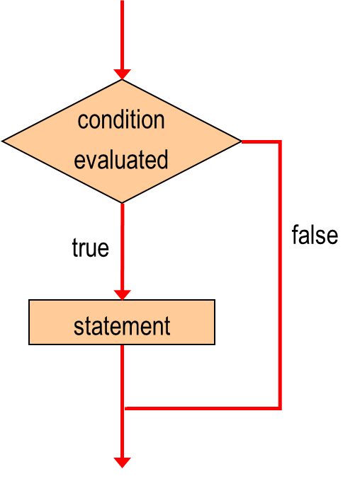
Logic of if statement

Slide 18
Nested statements
Both if-else statements and if statements can contain smaller statements within them
Another if-else or if statement can be used as a subpart of an if-else or if statement, making a nested conditional statements
For readability, it is always desirable to indent each level of a nested if-else or if further than the previous level

Slide 19
Example
//In the following code block, assume int n1, n2 and n3 already declared and assigned
if (n1 < n2) {
if (n1 < n3) {
//n1 is smallest
} else {
//n3 is smallest
}
} else {
if (n2 < n3) {
//n2 is smallest
} else {
//n3 is smallest
}
}

Slide 20
Indentation
Note that indentation is for the human reader, and is ignored by the compiler
if (depth >= UPPER_LIMIT)
delta = 100;
else
System.out.println("Reseting Delta");
delta = 0;
Despite what the indentation implies, delta will be set to 0 no matter what

Slide 21
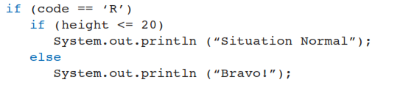
Example
Is the else clause matched to the inner if statement or the outer if statement?
An else clause is always matched to the closest unmatched if that preceded it.

Slide 22
The switch statement
The switch statement is used when multiple options are available
When a switch statement is evaluated, one of branches options is executed
The controlling expression enclosed in parentheses after the keyword switch is used to determine which branch to execute
Note that the controlling expression can be evaluated to a char, int, or String. It does not have to be Boolean expression.

Slide 23
The switch statement
Syntax of the switch statement
switch (Controlling_Expression)
{
case Case_1:
Statement_1
break;
case Case_2:
Statement_2
break;
…
default:
Default_Statement
break;
}
If expression matches case 2, control jumps to here
switch and case are reserved words
Default is optional.

Slide 24
The switch statement
A statement in the switch block can be labeled with one or more case or default labels. The switch statement evaluates its expression, then executes all statements that follow the matching case label.
Each break statement terminates the enclosing switch statement. Control flow continues with the first statement following the switch block.
All statements after the matching case label are executed in sequence, regardless of the expression of subsequent case labels, until a break statement is encountered.
https://docs.oracle.com/javase/tutorial/java/nutsandbolts/switch.html

Slide 25
Example
int month = 7;
String strMonth;
switch (month) {
case 1: strMonth = "January";
break;
case 2: strMonth = "February";
break;
case 7: strMonth = “July";
break;
case 9: strMonth = “September";
break;
default: strMonth = “Incorrect number";
break;
}
System.out.println(strMonth);

Slide 26
Loops
There are three types of loop statements in Java:
while loop, do-while loop, and for loop
Body of the loop: code that is repeated in a loop. The loop body can be a single statement, or multiple statements enclosed in a pair of braces { }
Iteration: each repetition of the loop body

Slide 27
The while statement
Syntax
while is a Java reserved word
The Boolean expression is checked before the loop body is executed. And checked again before each iteration
while ( Boolean_expression ) {
statement(s)
}
The loop body is executed if the condition is true, the loop stops if false

Slide 28
The while statement
A while statement is used to repeat the loop body based on the evaluation of a Boolean expression
In while loop, the Boolean expression is evaluated first. If the result of the evaluation is true, the loop body is executed. Then expression is again.
The process is repeated until the condition becomes false. Then the control jumps out of loop and continue on to the next statement after the loop
The loop body may not be executed at all.

Slide 29
Example
int count = 1;
while (count < 10)
{
System.out.println("Count value is: " + count);
count++;
}

Slide 30
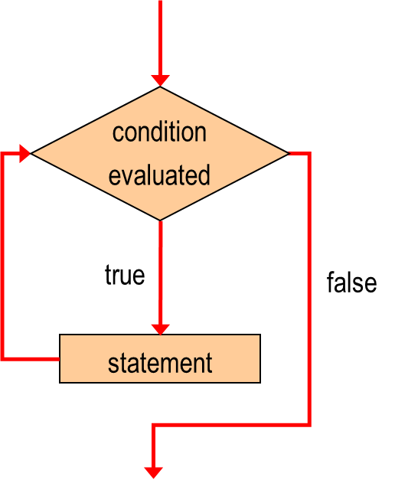
Logic of while loop

Slide 31
Infinite Loops
A well designed loop should always stop, which means that the execution of the loop body should eventually make the condition false.
If not, the loop will execute forever until the user interrupts the program, leading to an infinite loop.
An infinite loop is a common logical error, should always be avoided.

Slide 32
Infinite Loops
An example of an infinite loop:
int count = 1;
while (count <= 10)
{
System.out.println(“the count value is: ” + count);
count = count - 1;
}

Slide 33
Nested loops
Similar to conditional statements, one loop can be part of another loop. In other words, the body of one loop can have another loop
int count = 1; i = 1;
while (count <= 10) {
while ( i <= 10) {
i = i + 1;
}
count = count + 1;
}
The inner loop will be repeated completely for each repeat of the outer loop,

Slide 34
The do-while loop
Syntax
do {
statement(s)
} while (Boolean_expression);
do is a Java reserved word
Statements will be executed first before the condition is evaluated
Finishes with ;
while is Java reserved word
If the expression is true, the body is executed; if false, the loop stops and continues on to the next statement after the loop

Slide 35
The do-while loop
In do-while loop, the condition is evaluated at the bottom of the loop, while means the loop body will always be executed at least once
Example:
int count = 1;
do {
System.out.println("Count is: " + count);
count++;
} while (count < 10);

Slide 36
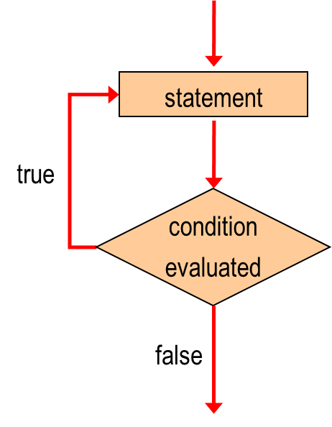
Logic of do-while loop

Slide 37
The for loop
The for loop is useful when some statements needed to be executed for a fixed number of times.
The for loop has three expressions in parentheses after the keyword for
The first expression declares and initialize the control variable
The second expression is a Boolean expression and determines when the loop should end
The third expression updates the control variable
The loop body will be executed 0 or more times

Slide 38
The for loop
Syntax
for (Initialization; Boolean_Expression; Update)
statement(s)
Initialization is executed first and once
The control variable is updated at the end of each iteration
for is a Java reserved word
Body of the loop
Statement(s) is executed until the
expression becomes false

Slide 39
The for loop
Example:
for(int i=10; i>1; i--){
System.out.println("The value of i is: “ + i);
}
In the example above,
int i=1 is initialization expression
i>1 is Boolean expression
i-- is Update expression

Slide 40
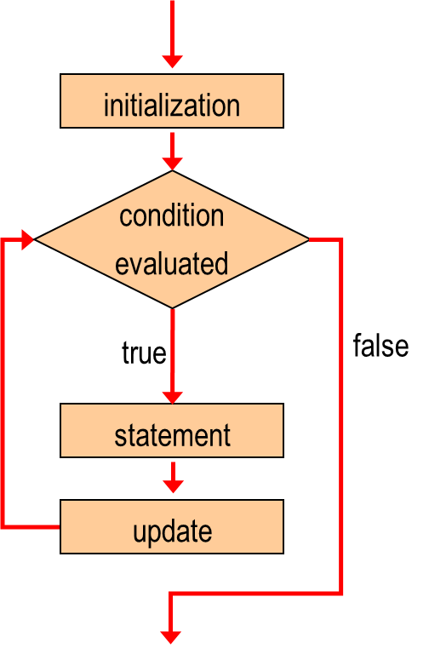
Logic of for loop

Slide 41
The three loops
The three types of loops are interchangeable. For example, for loop can be replaced using while loop as below:
initialization;
while ( condition )
{
statement(s);
update;
}

Slide 42
The three loops
In which situation, which loop should be used:
If the loop body needs to be executed at least once, use do-while loop
If we know how many iterations need to be executed, use for loop
Otherwise, use while loop

